Slide 1
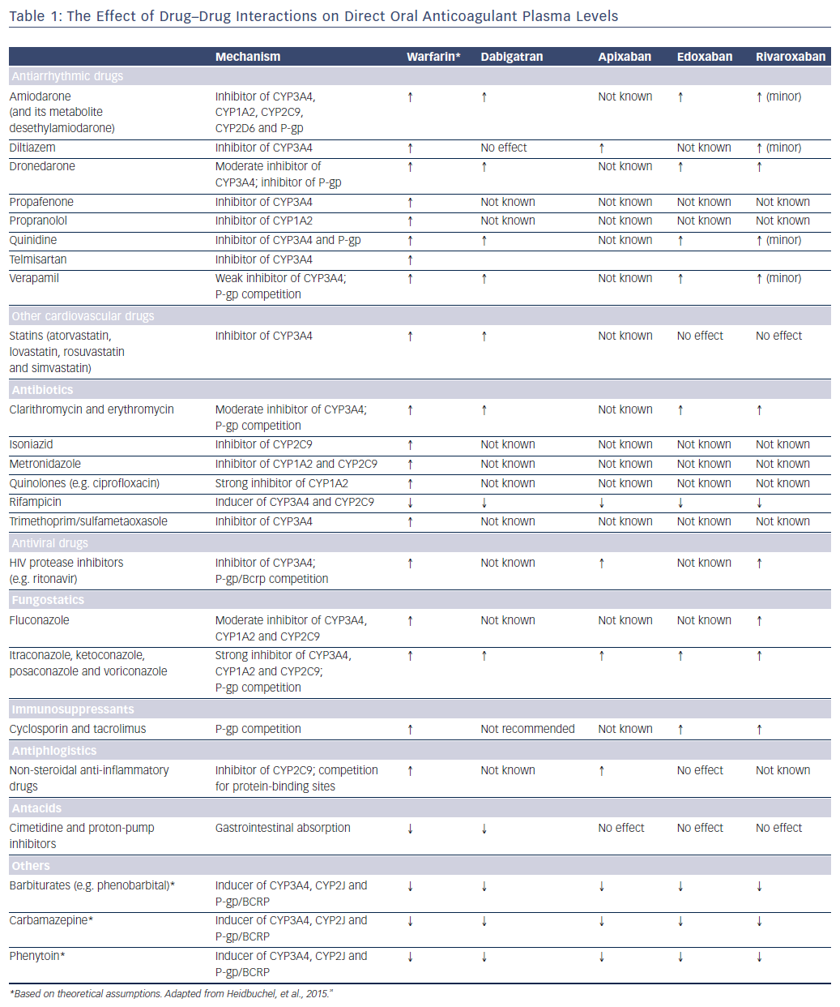
Vranckx P, Valgimigli M, Heidbuchel H
Table 1: The Effect of Drug–Drug Interactions on Direct Oral Anticoagulant Plasma Levels
Citation: Arrhythmia & Electrophysiology Review 2018;7(1):55–61.
https://doi.org/10.15420/aer.2017.50.1

