Slide 1

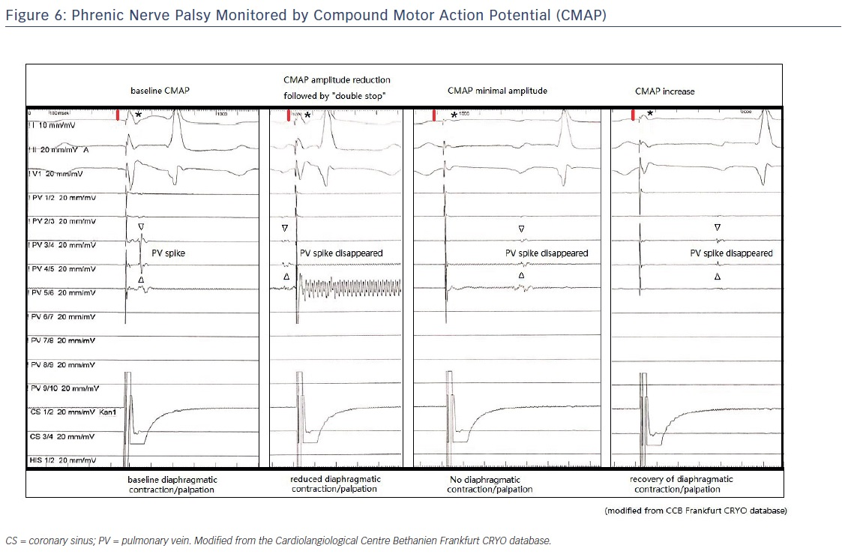
Chen S, Schmidt B, Bordignon S, Bologna F, Nagase T, Perrotta L, Chun KJ
Figure 6: Phrenic Nerve Palsy Monitored by Compound Motor Action Potential (CMAP)
Citation: Arrhythmia & Electrophysiology Review 2018;7(1):11–7.
https://doi.org/10.15420/aer.2018;1;2

