Slide 1
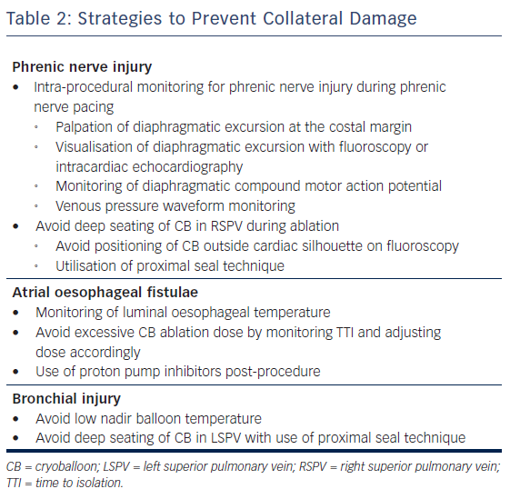
Kulkarni N, Su W, Wu R
Table 2: Strategies to Prevent Collateral Damage
Citation: Arrhythmia & Electrophysiology Review 2018;7(1):18–23.
https://doi.org/10.15420/aer.2017.32.1

