Slide 1
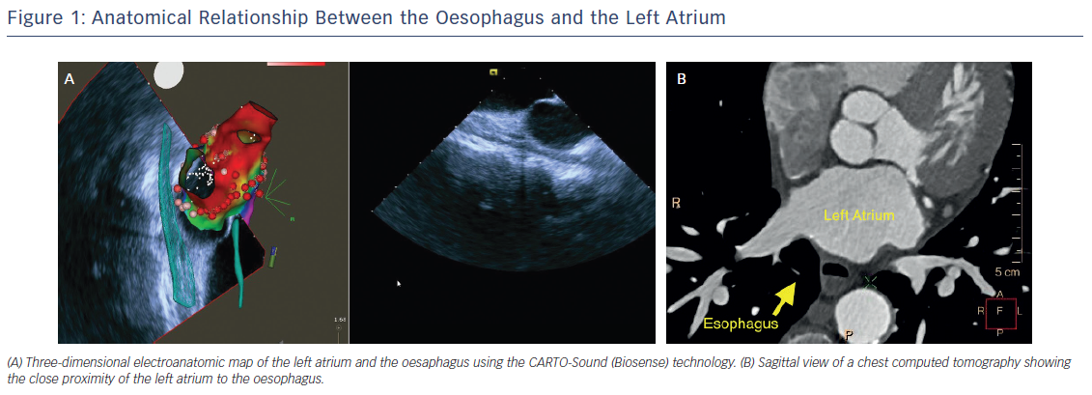
Romero JE, Avendano R, Grushko M, Diaz JC, Du X, Gianni C, Natale A, Di Biase L
Figure 1: Anatomical Relationship Between the Oesophagus and the Left Atrium
Citation: Arrhythmia & Electrophysiology Review 2018;7(1):24–31.
https://doi.org/10.15420/aer.2017.46.2

