Slide 1
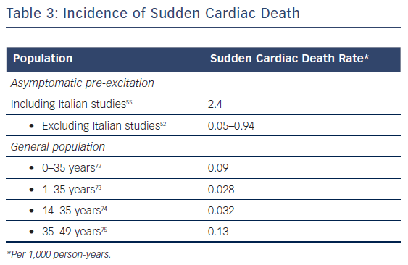
Brugada J, Keegan R
Table 3: Incidence of Sudden Cardiac Death
Citation: Arrhythmia & Electrophysiology Review 2018;7(1):32–8.
https://doi.org/10.15420/aer.2017.51.2

