Slide 1

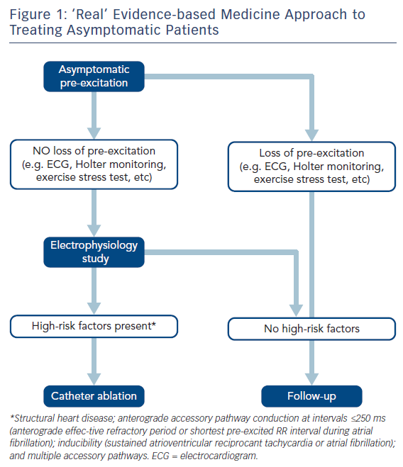
Brugada J, Keegan R
Figure 1: ‘Real’ Evidence-based Medicine Approach to Treating Asymptomatic Patients
Citation: Arrhythmia & Electrophysiology Review 2018;7(1):32–8.
https://doi.org/10.15420/aer.2017.51.2

