Slide 1
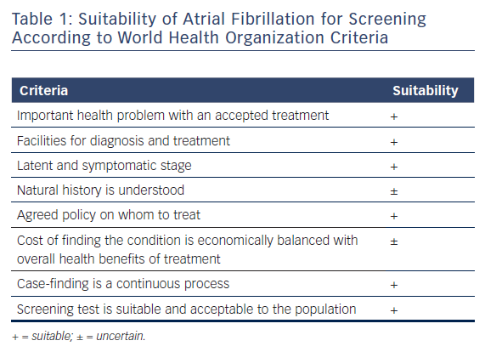
Chan NY
Table 1: Suitability of Atrial Fibrillation for Screening According to World Health Organization Criteria
Citation: Arrhythmia & Electrophysiology Review 2018;7(1):39–42.
https://doi.org/10.15420/aer.2017.47.2

