Slide 1
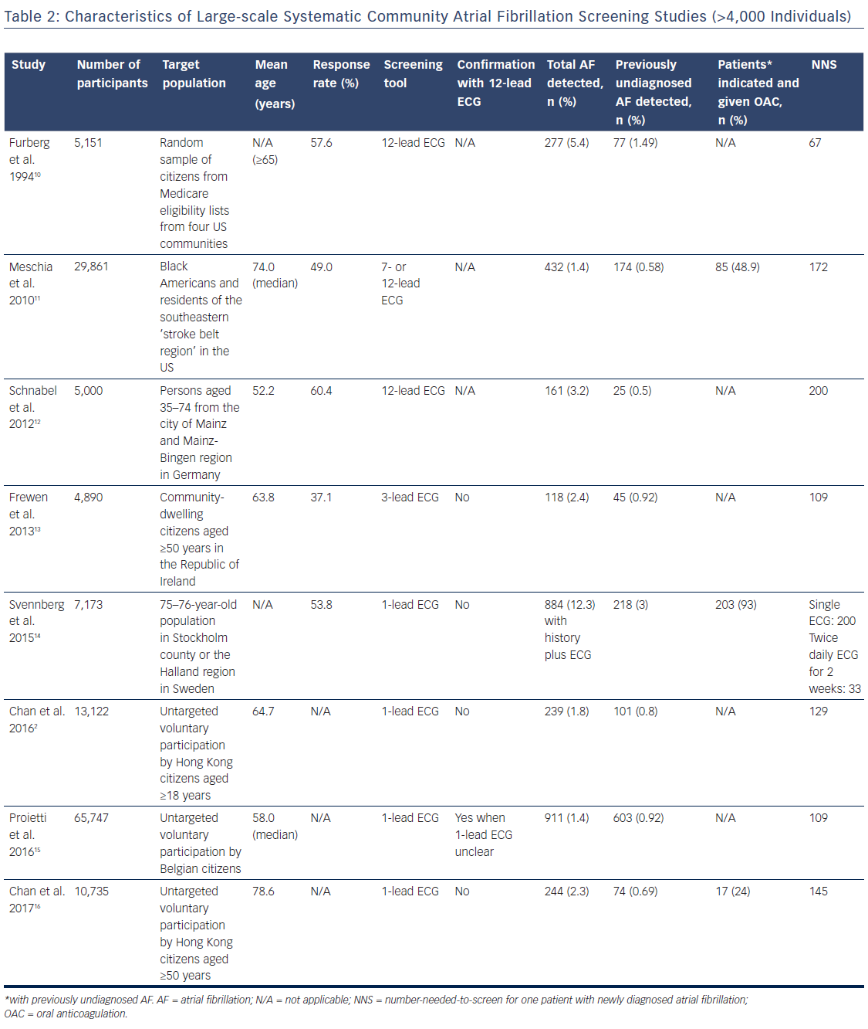
Chan NY
Table 2: Characteristics of Large-scale Systematic Community Atrial Fibrillation Screening Studies (&gt;4,000 Individuals)
Citation: Arrhythmia & Electrophysiology Review 2018;7(1):39–42.
https://doi.org/10.15420/aer.2017.47.2

