Slide 1
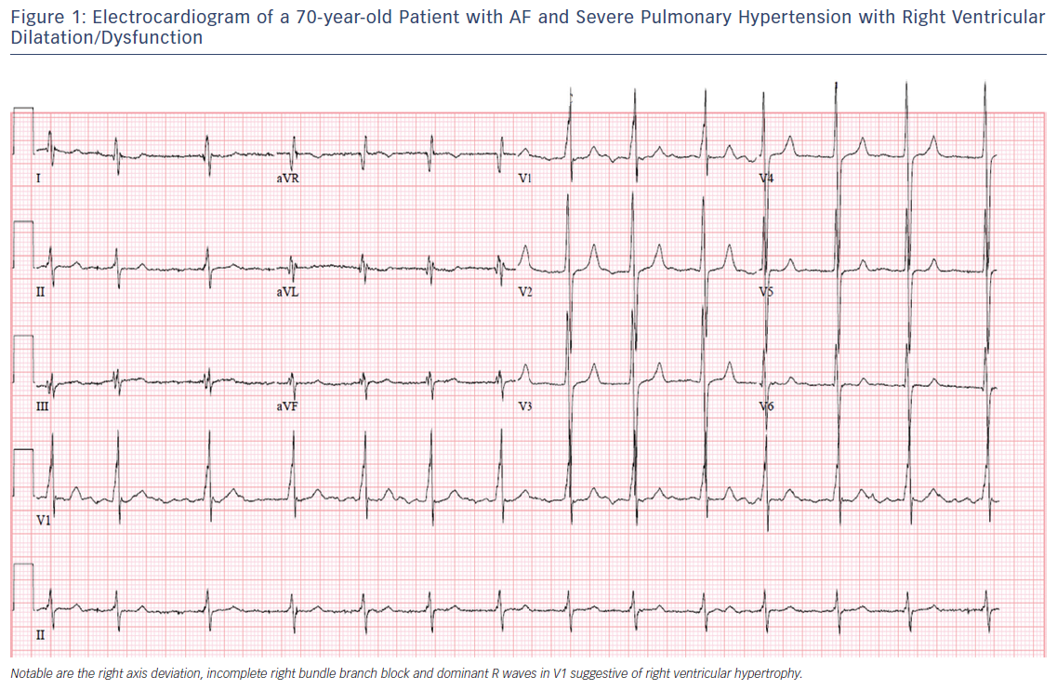
Wanamaker B, Cascino T, McLaughlin VV, Oral H, Latchamsetty R, Siontis KC
Figure 1: Electrocardiogram of a 70-year-old Patient with AF and Severe Pulmonary Hypertension with Right Ventricular Dilatation/Dysfunction
Citation: Arrhythmia & Electrophysiology Review 2018;7(1):43–8.
https://doi.org/10.15420/aer.2018.3.2

