Slide 1
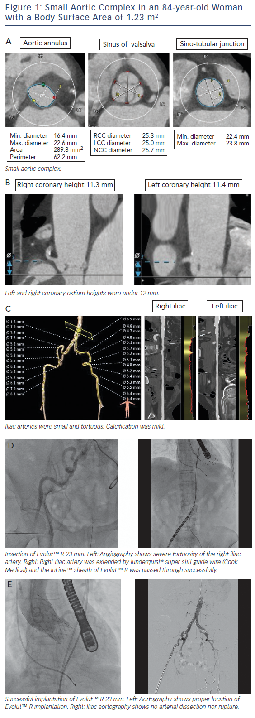
Watanabe Y, Nakashima M
Figure 1: Small Aortic Complex in an 84-year-old Woman with a Body Surface Area of 1.23 m2
Citation: Interventional Cardiology Review 2018;13(2):66–8.
https://doi.org/10.15420/icr.2017:28:1

