Slide 1
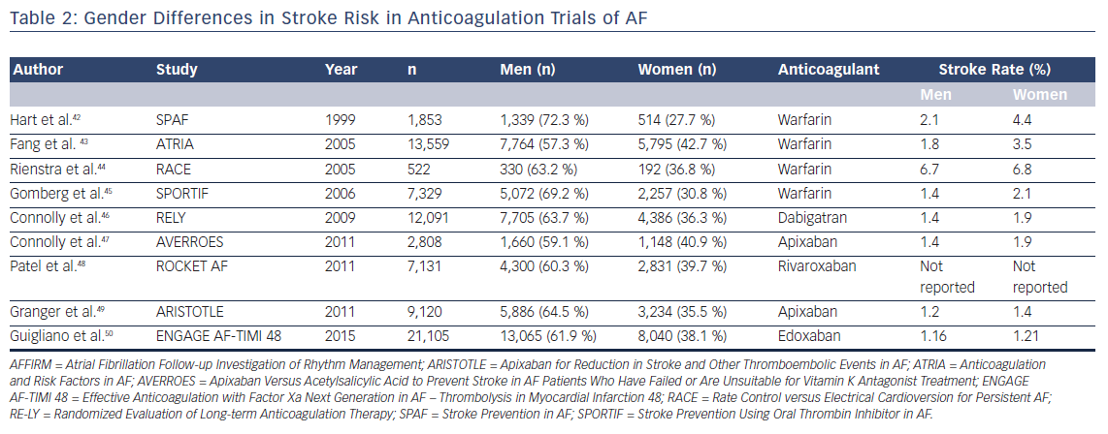
Pothineni NV, Vallurupalli S
Table 2: Gender Differences in Stroke Risk in Anticoagulation Trials of AF
Citation: US Cardiology Review 2018;12(2):103–6.
https://doi.org/10.15420/usc.2017:39:1

