Slide 1
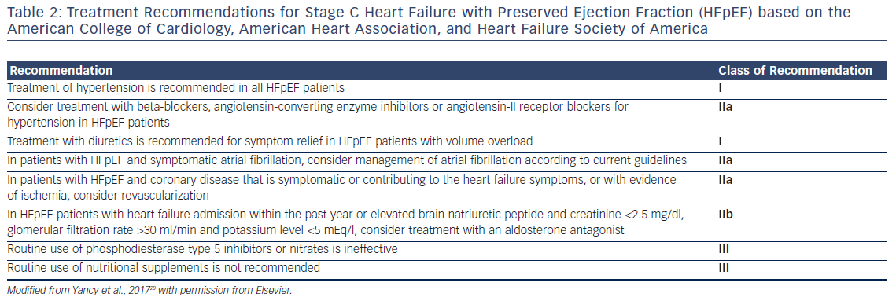
Soni M, Birati EY
Table 2: Treatment Recommendations for Stage C Heart Failure with Preserved Ejection Fraction
Citation: US Cardiology Review 2018;12(1):8–12.
https://doi.org/10.15420/usc.2017:21:1

