Slide 1
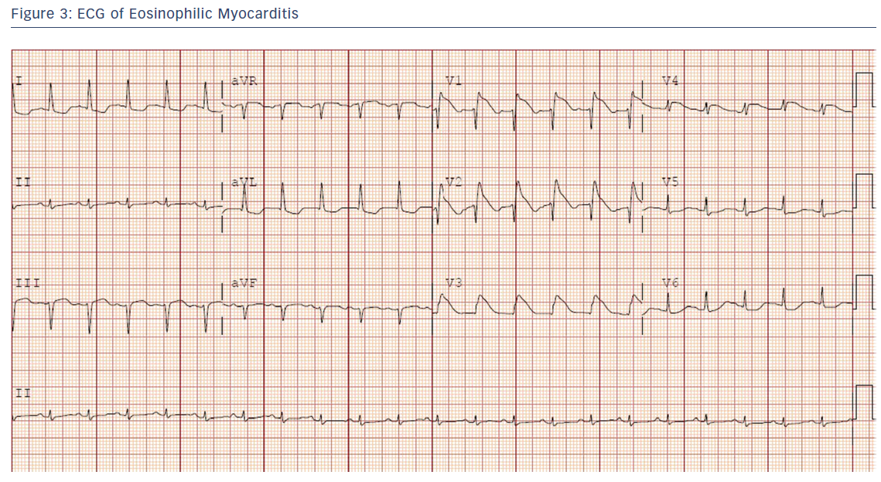
Seif E, Chen L, Goldman B
Figure 3: ECG of Eosinophilic Myocarditis
Citation: US Cardiology Review 2018;12(1):13–6.
https://doi.org/10.15420/usc.2017:31:1

