Slide 1
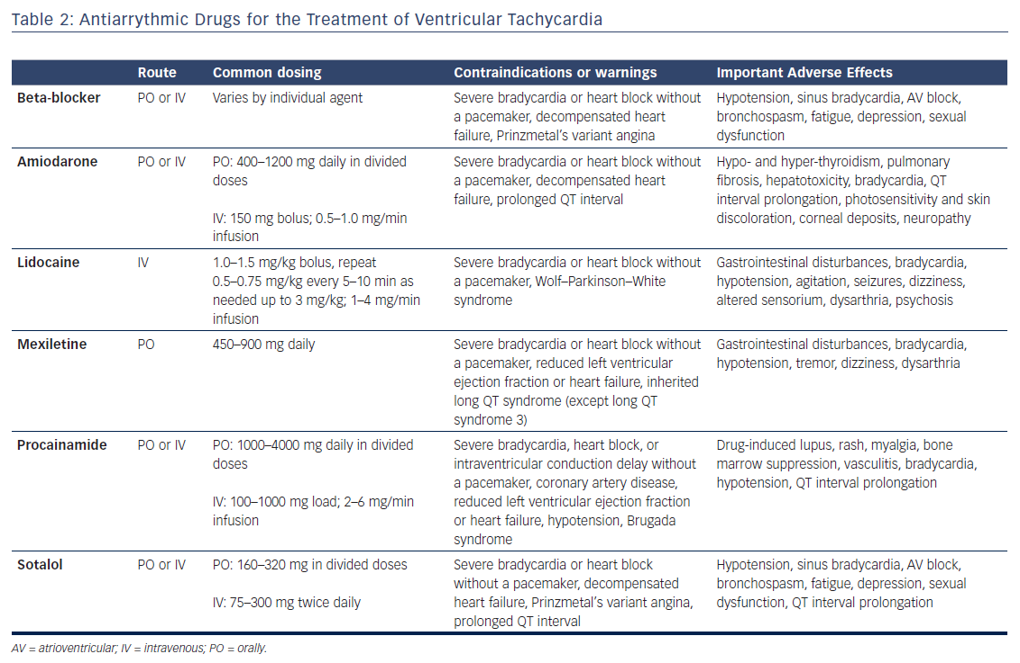
Markman TM, McBride DA, Liang JJ
Table 2: Antiarrythmic Drugs for the Treatment of Ventricular Tachycardia
Citation: US Cardiology Review 2018;12(1):51–6.
https://doi.org/10.15420/usc.2017:28:3

