Slide 1
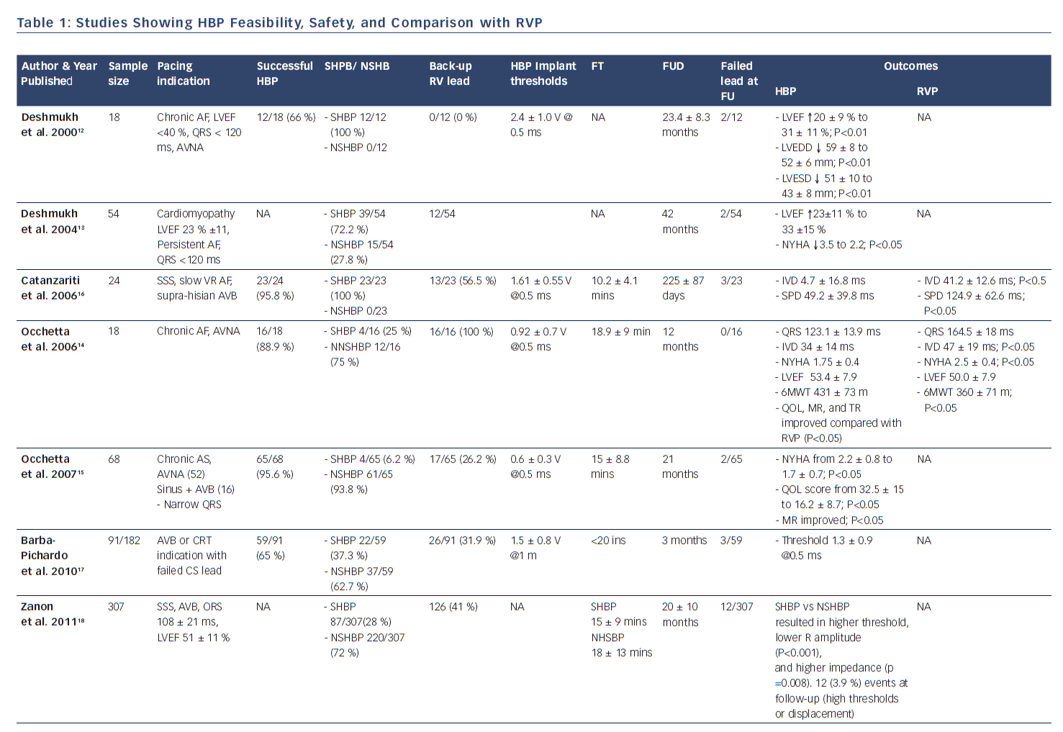
Yuyun MF, Chaudhry GM
Table 1: Studies Showing HBP Feasibility, Safety, and Comparison with RVP
Citation: US Cardiology Review 2018;12(1):57–65.
https://doi.org/10.15420/usc:2017:36:2

