Slide 1
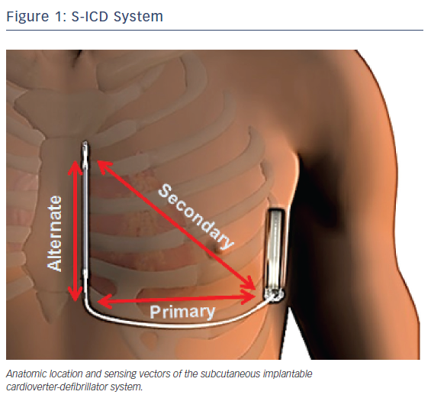
Turnage TA, Kpaeyeh JA, Gold MR
Figure 1: S-ICD System
Citation: US Cardiology Review 2018;12(1):66–70.
https://doi.org/10.15420/usc.2017:37:1

