Slide 1
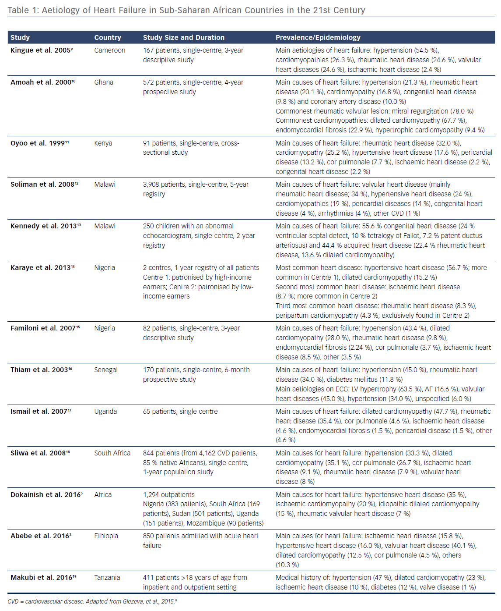
Gallagher J, McDonald K, Ledwidge M, Watson C, Gallagher J
Heart Failure in Sub-Saharan Africa
Citation: Cardiac Failure Review 2018;4(1):21–4.
https://doi.org/10.15420/cfr.2018:4:1

