Slide 1
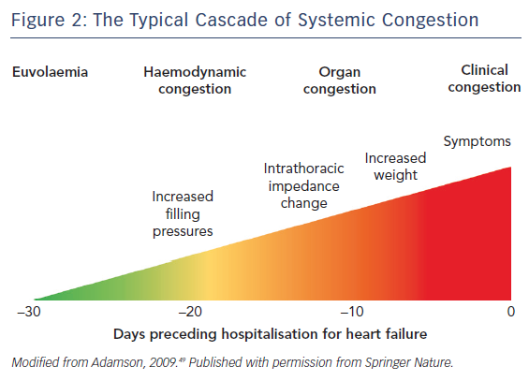
Arrigo M, Nijst P, Rudiger A
Figure 2: The Typical Cascade of Systemic Congestion
Citation: Cardiac Failure Review 2018;4(1):38–42.
https://doi.org/10.15420/cfr.2017:21:1

