Slide 1
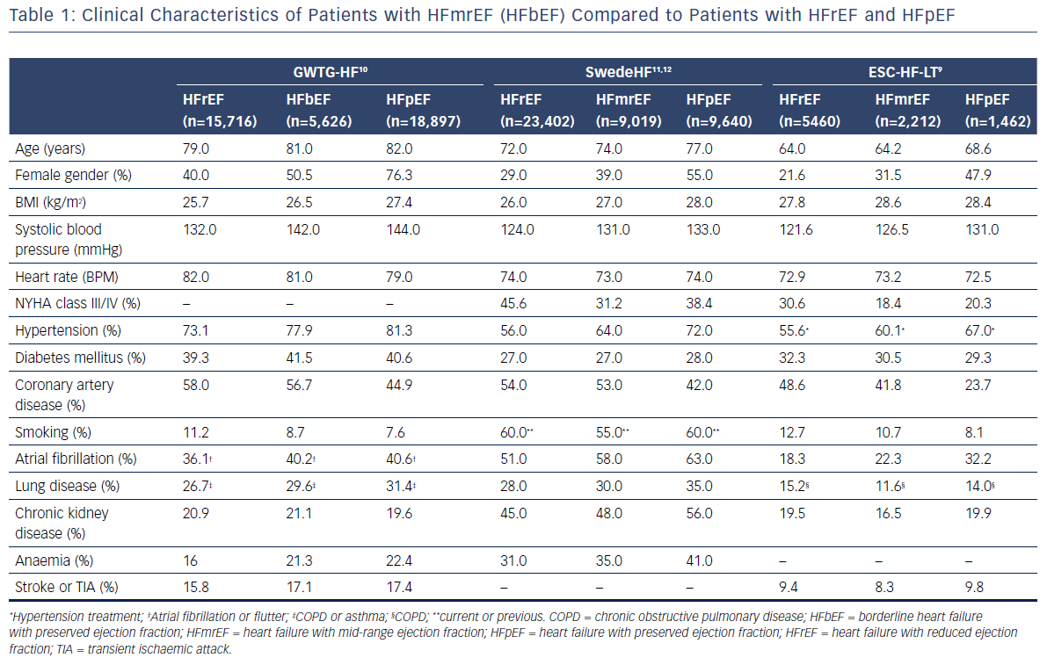
Lopatin Y
Table 1: Clinical Characteristics of Patients with HFmrEF (HFbEF) Compared to Patients with HFrEF and HFpEF
Citation: Cardiac Failure Review 2018;4(1):9–13.
https://doi.org/10.15420/cfr.2018:10:1

