Slide 1
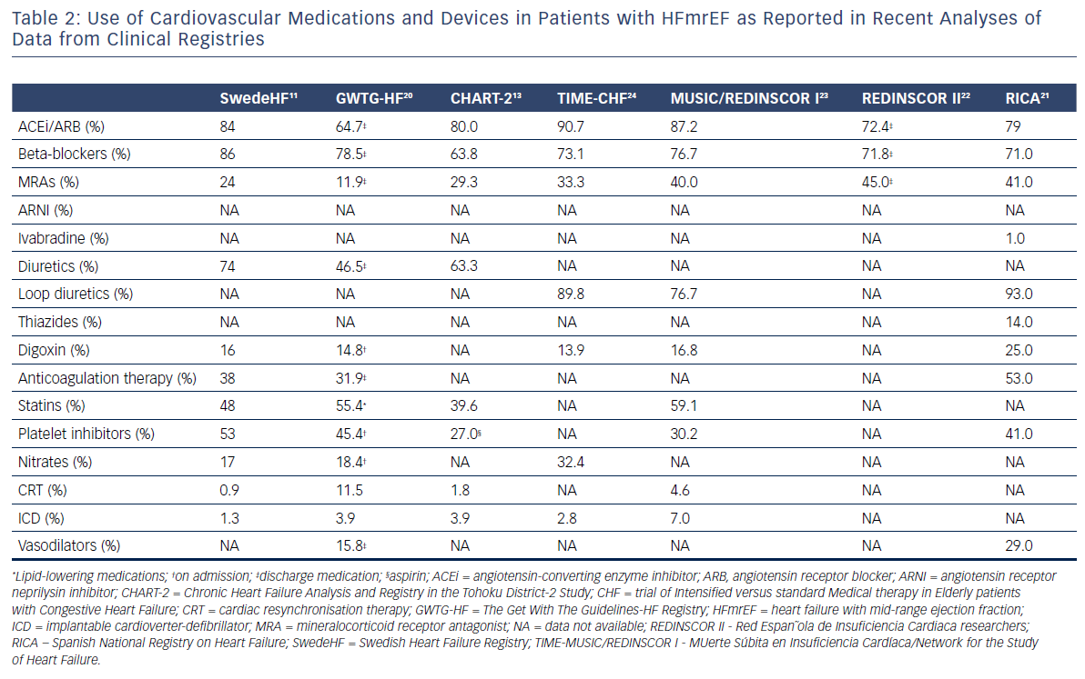
Lopatin Y
Table 2: Use of Cardiovascular Medications and Devices in Patients with HFmrEF as Reported in Recent Analyses of Data from Clinical Registries
Citation: Cardiac Failure Review 2018;4(1):9–13.
https://doi.org/10.15420/cfr.2018:10:1

