Slide 1
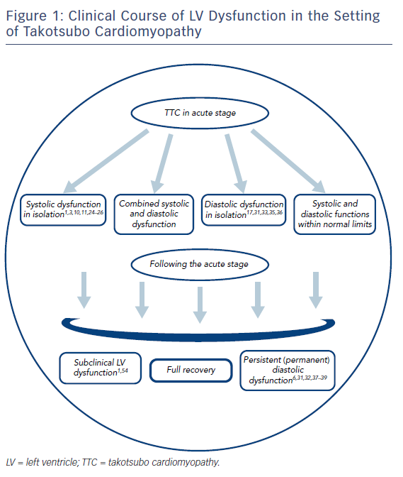
Yalta K, Yılmaztepe M, Zorkun C
Figure 1: Clinical Course of LV Dysfunction in the Setting of Takotsubo Cardiomyopathy
Citation: Cardiac Failure Review 2018;4(1):14–20.
https://doi.org/10.15420/cfr.2018:24:2

