Slide 1
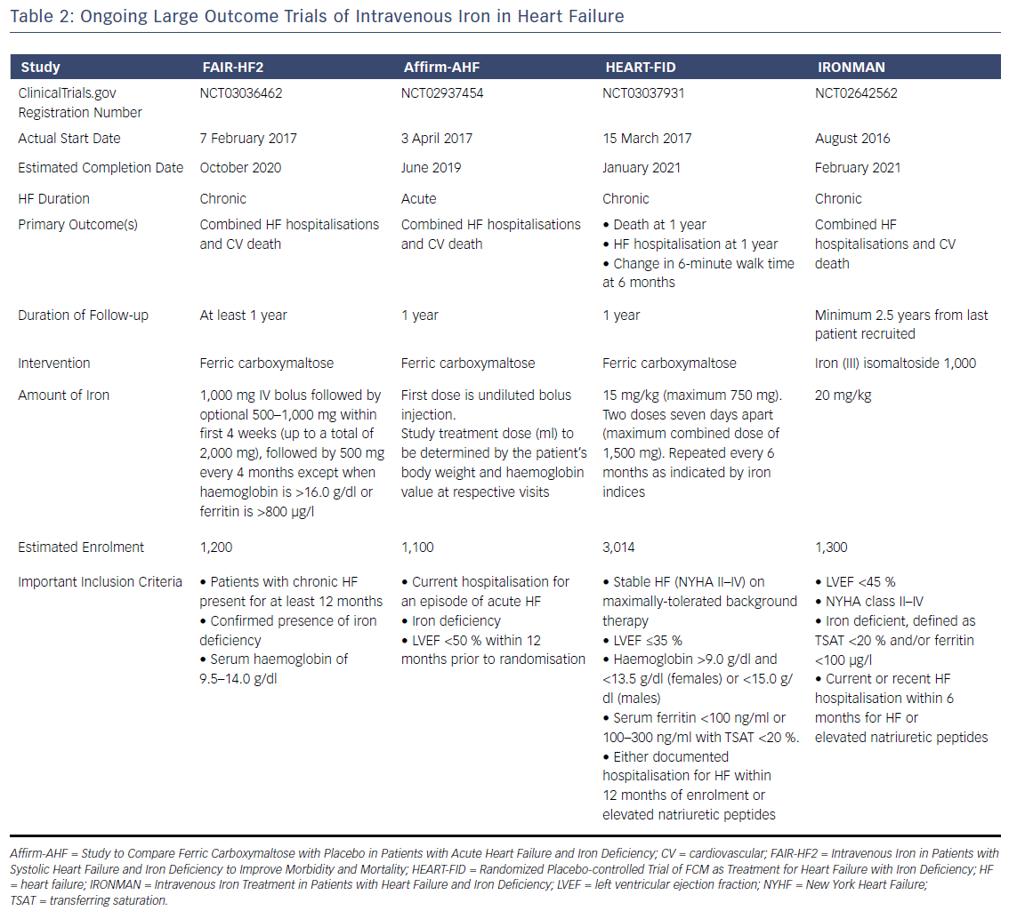
Mordi IR, Tee A, Lang CC
Table 2: Ongoing Large Outcome Trials of Intravenous Iron in Heart Failure
Citation: Cardiac Failure Review 2018;4(1):28–32.
https://doi.org/10.15420/cfr.2018:6:2

