Slide 1
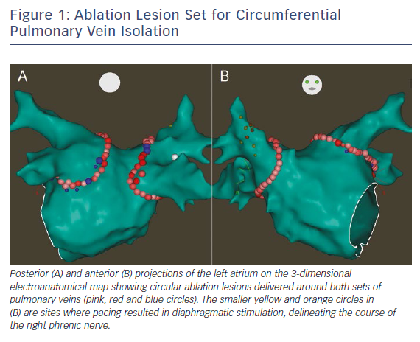
Liang JJ, Callans DJ
Figure 1: Ablation Lesion Set for Circumferential Pulmonary Vein Isolation
Citation: Cardiac Failure Review 2018;4(1):33–7.
https://doi.org/10.15420/cfr.2018:3:1

