Slide 1
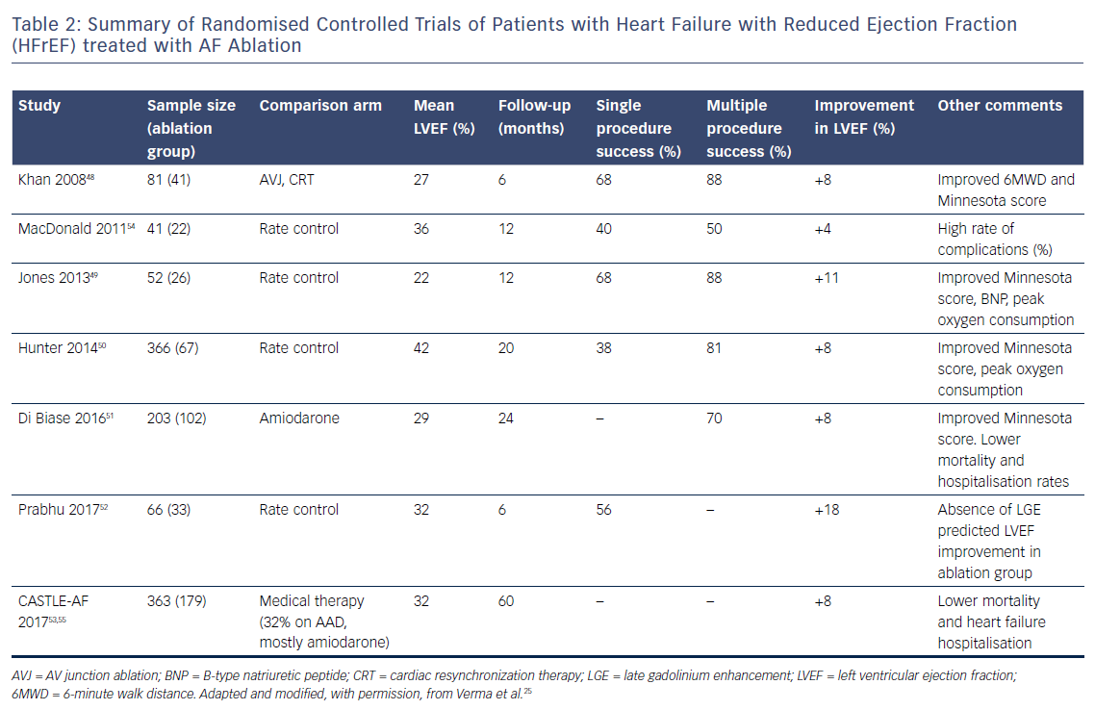
Liang JJ, Callans DJ
Table 2: Summary of Randomised Controlled Trials of Patients with Heart Failure with Reduced Ejection Fraction (HFrEF) treated with AF Ablation
Citation: Cardiac Failure Review 2018;4(1):33–7.
https://doi.org/10.15420/cfr.2018:3:1

