Slide 1
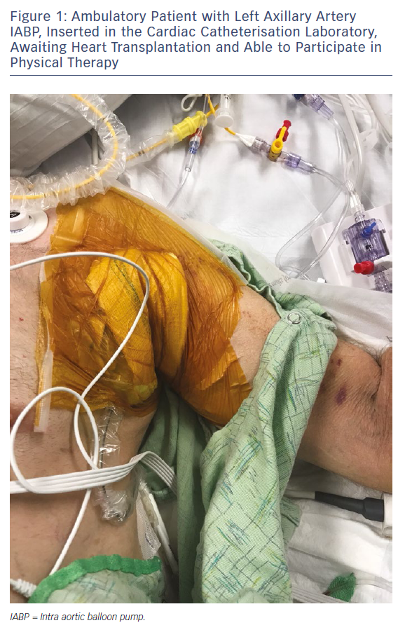
Naqvi SY, Salama IG, Yoruk A, Chen L
Figure 1: Ambulatory Patient with Left Axillary Artery IABP, Inserted in the Cardiac Catheterisation Laboratory, Awaiting Heart Transplantation and Able to Participate in Physical Therapy
Citation: Cardiac Failure Review 2018;4(1):43–5.
https://doi.org/10.15420/cfr.2018:22:1

