Slide 1
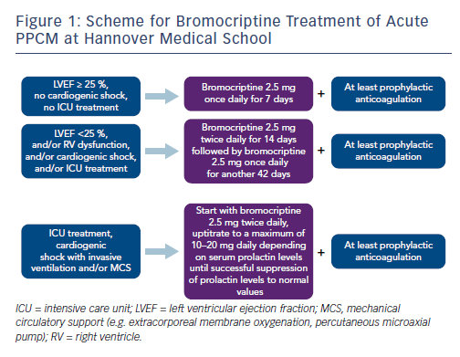
Koenig T, Bauersachs J, Hilfiker-Kleiner D
Figure 1: Scheme for Bromocriptine Treatment of Acute PPCM at Hannover Medical School
Citation: Cardiac Failure Review 2018;4(1):46–9.
https://doi.org/10.15420/cfr.2018:2:2

