Slide 1
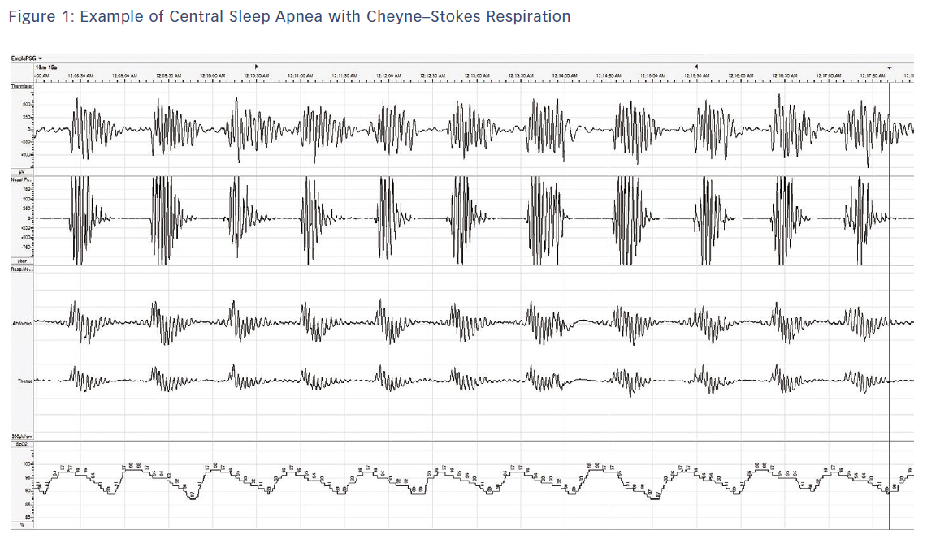
Abraham WT, Pleister A, Germany R
Figure 1: Example of Central Sleep Apnea with Cheyne–Stokes Respiration
Citation: Cardiac Failure Review 2018;4(1):50–3.
https://doi.org/10.15420/cfr.2018:9:1

