Slide 1
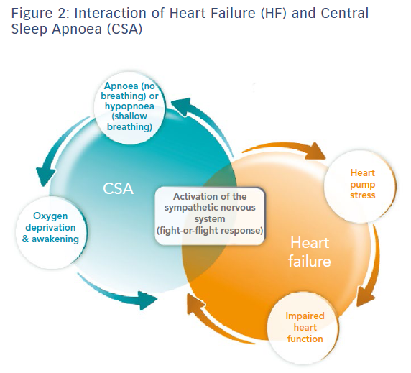
Abraham WT, Pleister A, Germany R
Figure 2: Interaction of Heart Failure (HF) and Central Sleep Apnoea (CSA)
Citation: Cardiac Failure Review 2018;4(1):50–3.
https://doi.org/10.15420/cfr.2018:9:1

