Slide 1
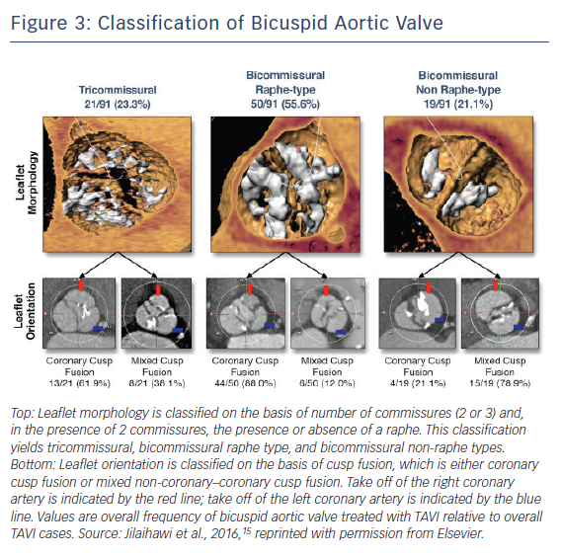
Yoon SH, Maeno Y, Kawamori H, Miyasaka M, Nomura T, Ochiai T, Nemanpour S, Raschpichler M, Chakravarty T, Makkar R
Figure 3: Classification of Bicuspid Aortic Valve
Citation: Interventional Cardiology Review 2018;13(2):62–5.
https://doi.org/10.15420/icr.2018:8:2

