Slide 1
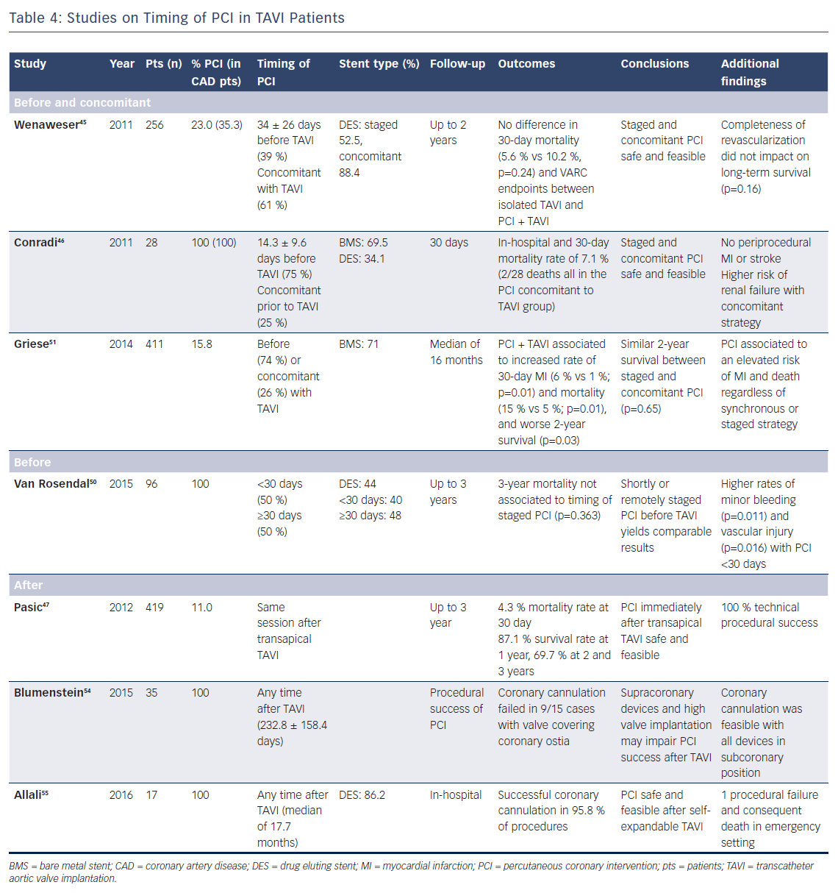
Cao D, Chiarito M, Pagnotta P, Reimers B, Stefanini GG
Table 4: Studies on Timing of PCI in TAVI Patients
Citation: Interventional Cardiology Review 2018;13(2):69–76.
https://doi.org/10.15420/icr.2018:2:2

