Slide 1
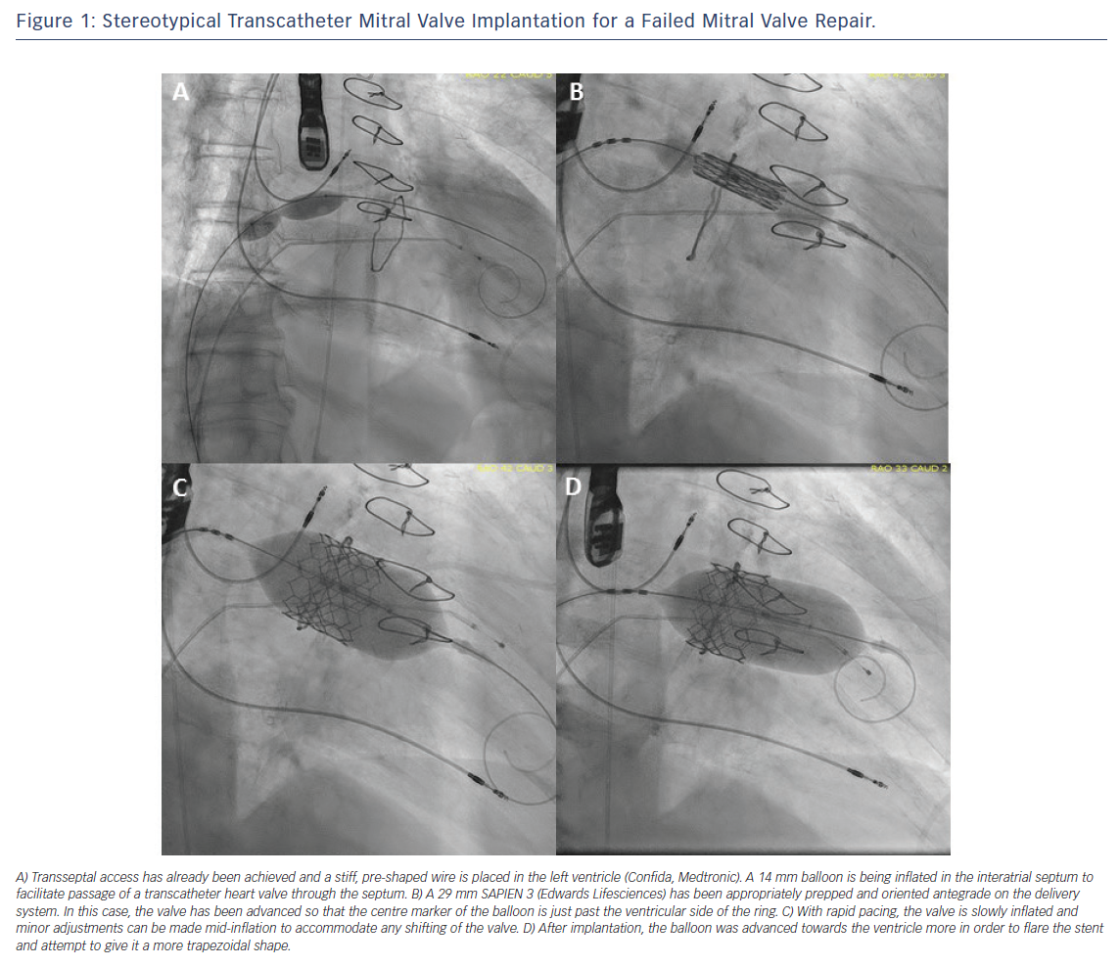
Eng MH, Wang DD
Figure 1: Stereotypical Transcatheter Mitral Valve Implantation for a Failed Mitral Valve Repair
Citation: Interventional Cardiology Review 2018;13(2):77–80.
https://doi.org/10.15420/icr.2017:16:3

