Slide 1
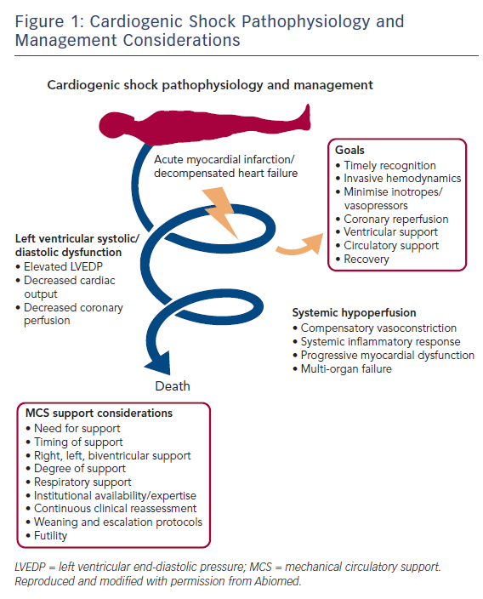
Truesdell AG, Tehrani B, Singh R, Desai S, Saulino P, Barnett S, Lavanier S, Murphy C
Figure 1: Cardiogenic Shock Pathophysiology and Management Considerations
Citation: Interventional Cardiology Review 2018;13(2):81–6.
https://doi.org/10.15420/icr.2017:35:3

