Slide 1
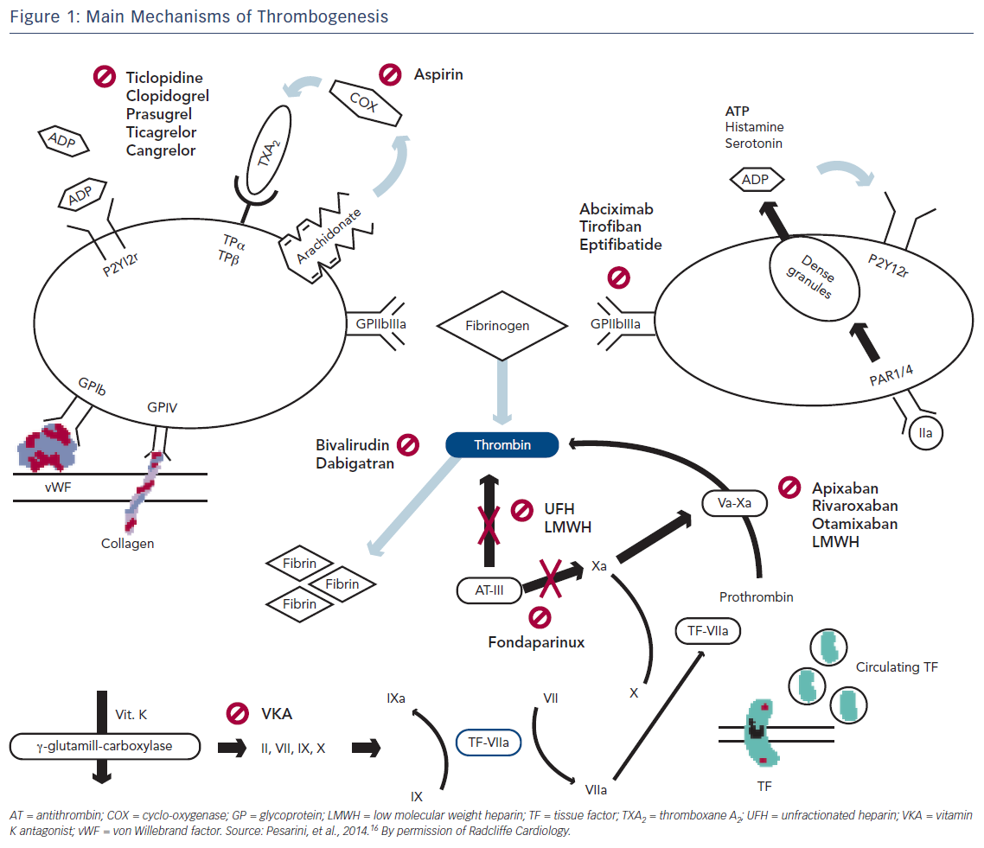
Onwordi EN, Gamal A, Zaman A
Figure 1: Main Mechanisms of Thrombogenesis
Citation: Interventional Cardiology Review 2018;13(2):87–92.
https://doi.org/10.15420/icr.2017:26:1

