Slide 1
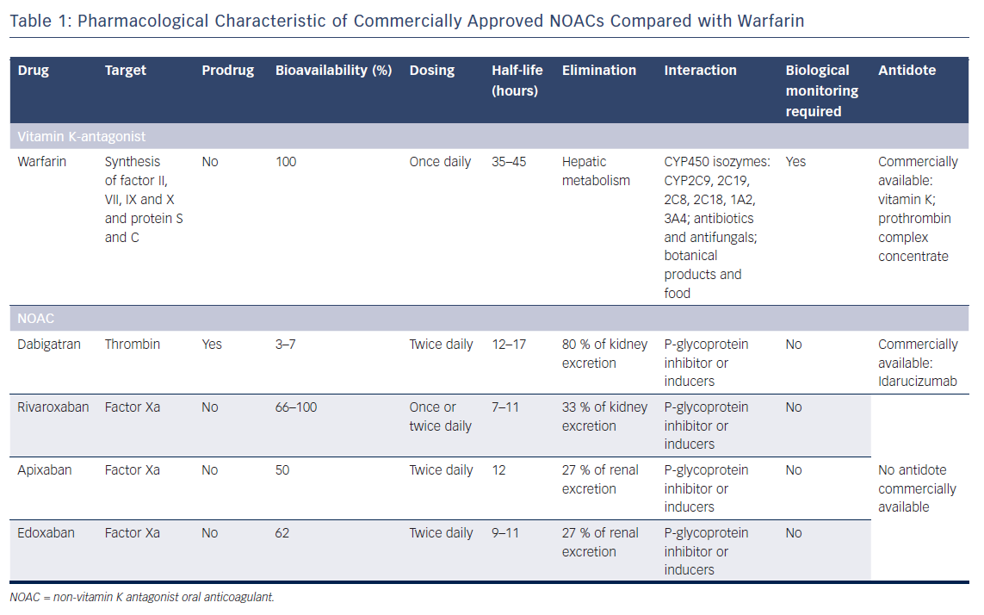
Guedeney P, Vogel B, Mehran R
Table 1: Pharmacological Characteristic of Commercially Approved NOACs Compared with Warfarin
Citation: Interventional Cardiology Review 2018;13(2):93–8.
https://doi.org/10.15420/icr.2018:5:2

