Slide 1
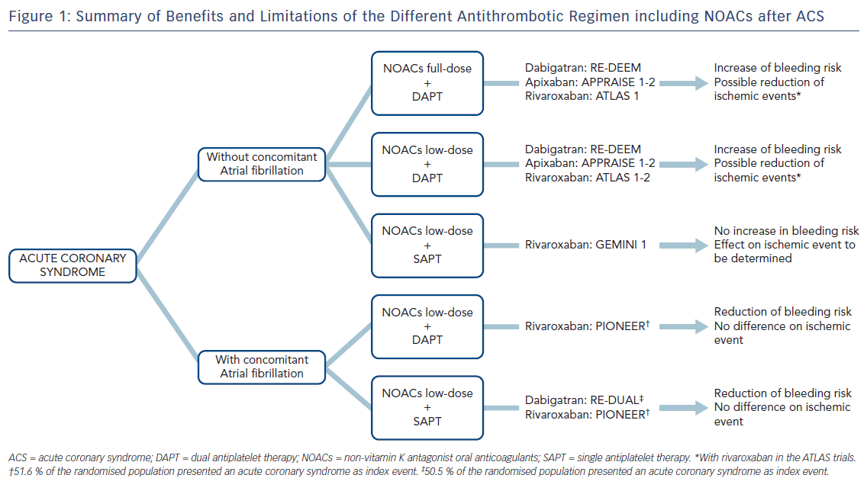
Guedeney P, Vogel B, Mehran R
Figure 1: Summary of Benefits and Limitations of the Different Antithrombotic Regimen including NOACs after ACS
Citation: Interventional Cardiology Review 2018;13(2):93–8.
https://doi.org/10.15420/icr.2018:5:2

