Slide 1
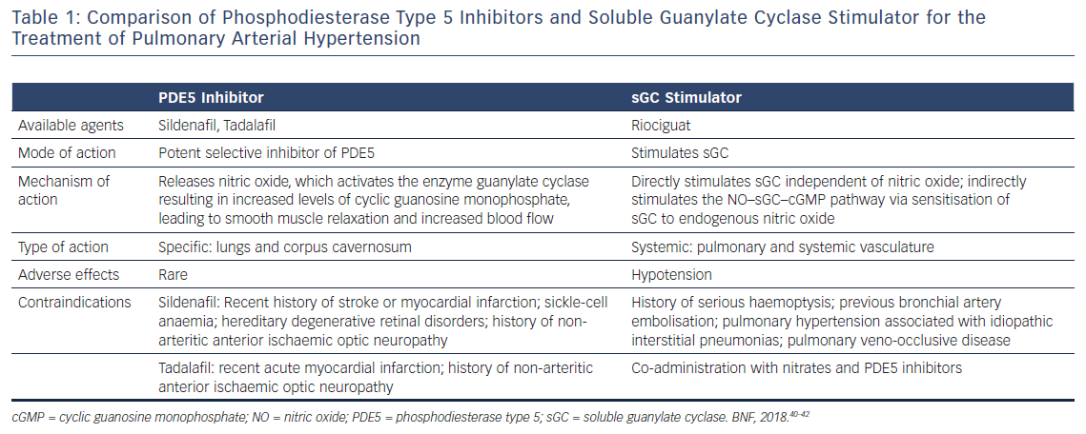
Watanabe H
Table 1: Comparison of Phosphodiesterase Type 5 Inhibitors and Soluble Guanylate Cyclase Stimulator for the Treatment of Pulmonary Arterial Hypertension
Citation: European Cardiology Review 2018;13(1):35–7.
https://doi.org/10.15420/ecr.2017:22:2

