Slide 1
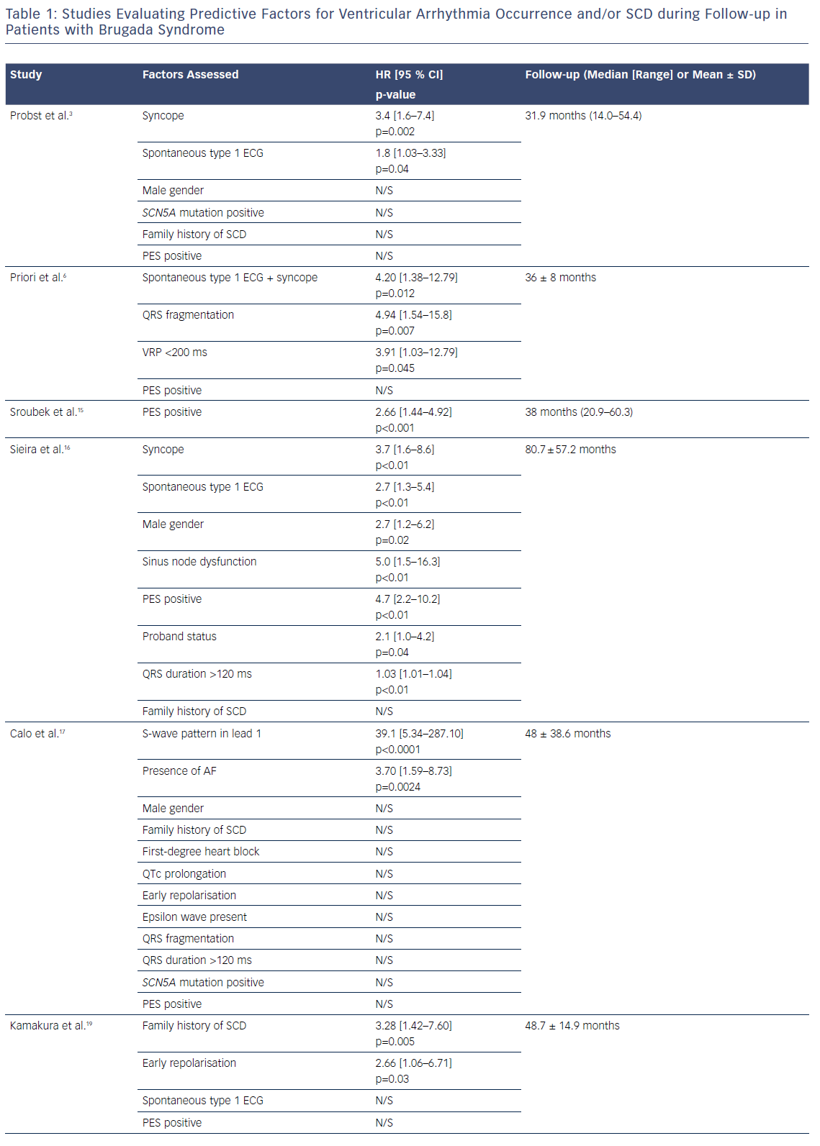
Honarbakhsh S, Providencia R, Lambiase PD
Table 1: Studies Evaluating Predictive Factors for Ventricular Arrhythmia Occurrence and/or SCD during Follow-up in Patients with Brugada Syndrome
Citation: Arrhythmia & Electrophysiology Review 2018;7(2):79–83.
https://doi.org/10.15420/aer.2018.2.2

