Slide 1
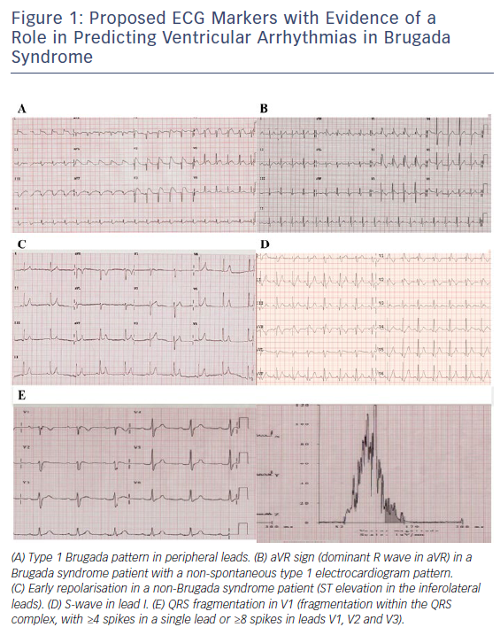
Honarbakhsh S, Providencia R, Lambiase PD
Figure 1: Proposed ECG Markers with Evidence of a Role in Predicting Ventricular Arrhythmias in Brugada Syndrome
Citation: Arrhythmia & Electrophysiology Review 2018;7(2):79–83.
https://doi.org/10.15420/aer.2018.2.2

