Slide 1
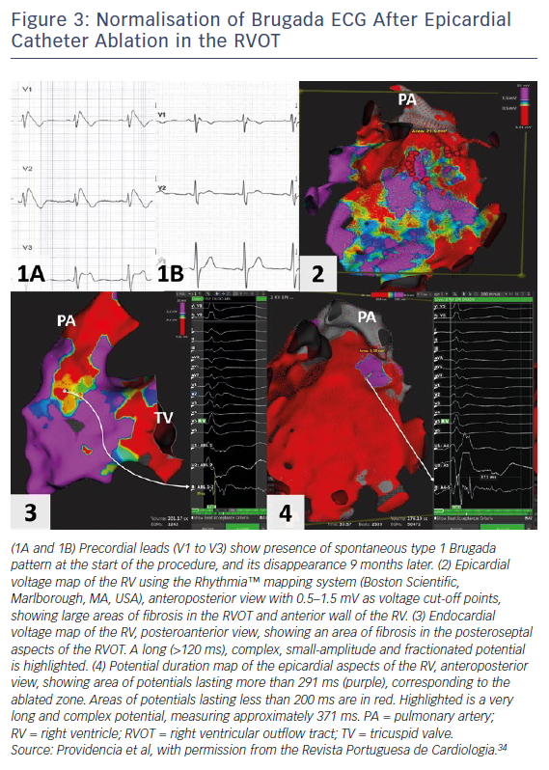
Honarbakhsh S, Providencia R, Lambiase PD
Figure 3: Normalisation of Brugada ECG After Epicardial Catheter Ablation in the RVOT
Citation: Arrhythmia & Electrophysiology Review 2018;7(2):79–83.
https://doi.org/10.15420/aer.2018.2.2

