Slide 1
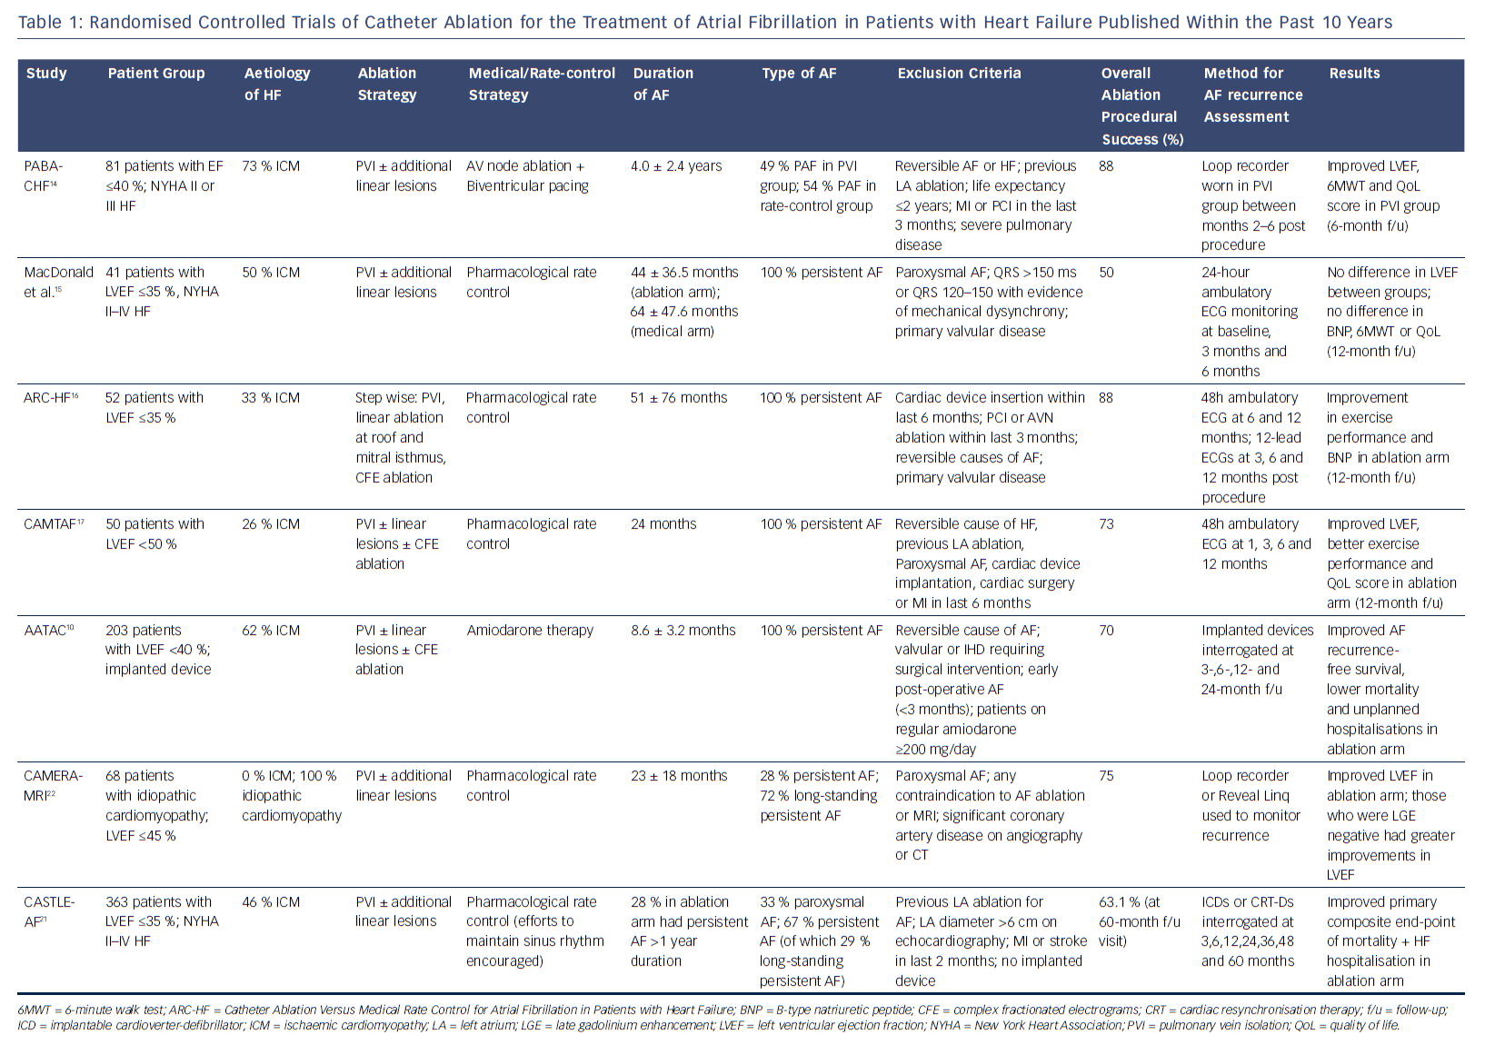
Mukherjee RK, Williams SE, Niederer S, O’Neill MD
Table 1: Randomised Controlled Trials of Catheter Ablation for the Treatment of Atrial Fibrillation in Patients with Heart Failure Published Within the Past 10 Years
Citation: Arrhythmia & Electrophysiology Review 2018;7(2):84–90.
https://doi.org/10.15420/aer.2018.11.3

