Slide 1

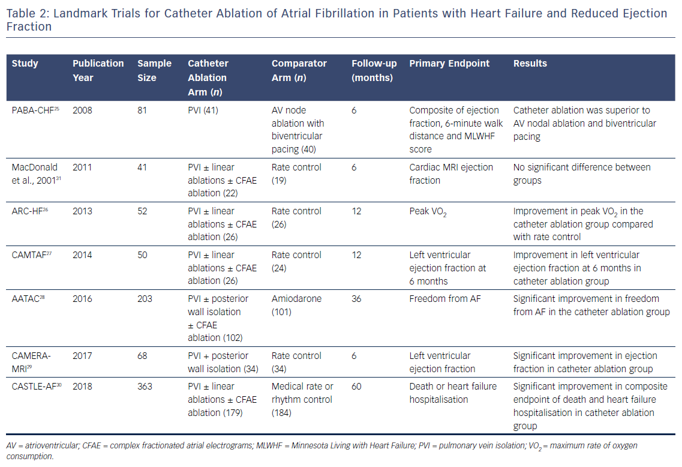
Baher A, Marrouche NF
Table 2: Landmark Trials for Catheter Ablation of Atrial Fibrillation in Patients with Heart Failure and Reduced Ejection Fraction
Citation: Arrhythmia & Electrophysiology Review 2018;7(2):91–4.
https://doi.org/10.15420/aer.2018.17.2

