Slide 1
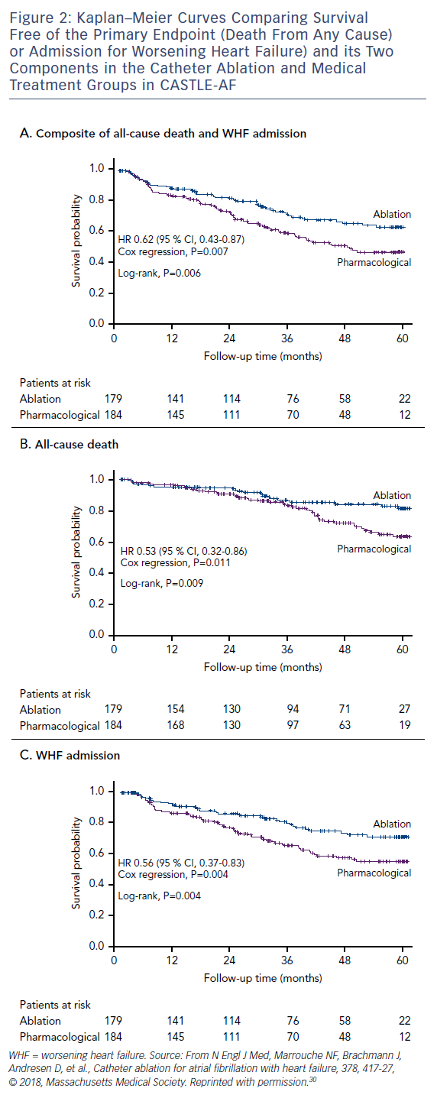
Baher A, Marrouche NF
Figure 2: Kaplan–Meier Curves Comparing Survival Free of the Primary Endpoint (Death From Any Cause) or Admission for Worsening Heart Failure) and its Two Components in the Catheter Ablation and Medical Treatment Groups in CASTLE-AF
Citation: Arrhythmia & Electrophysiology Review 2018;7(2):91–4.
https://doi.org/10.15420/aer.2018.17.2

