Slide 1
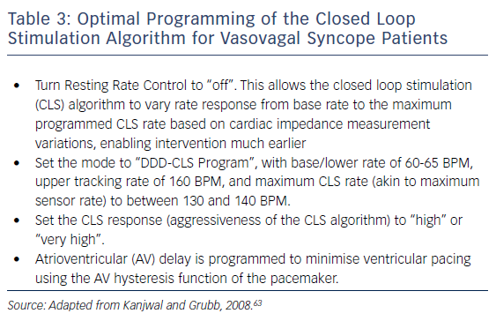
Gopinathannair R, Salgado BC, Olshansky B
Table 3: Optimal Programming of the Closed Loop Stimulation Algorithm for Vasovagal Syncope Patients
Citation: Arrhythmia & Electrophysiology Review 2018;7(2):95–102.
https://doi.org/10.15420/aer.2018.22.2

