Slide 1
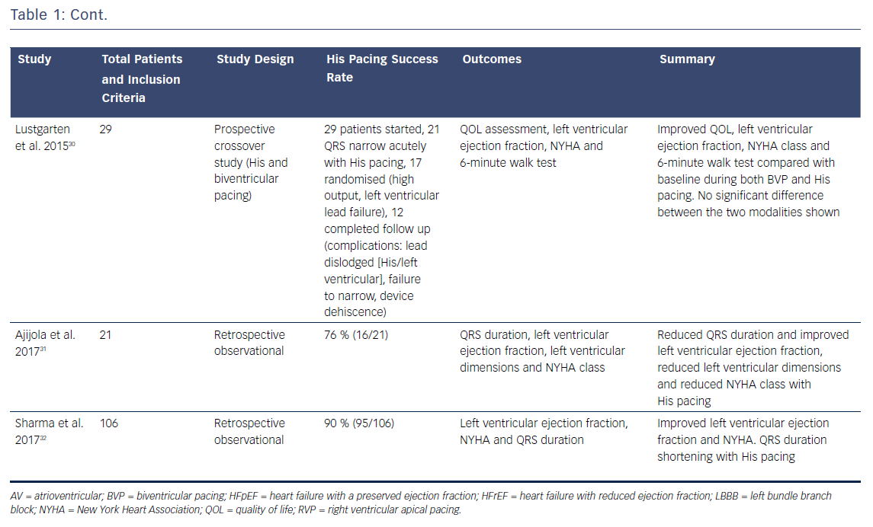
Ali N, Keene D, Arnold AD, Shun-Shin MJ, Whinnett Z, Sohaib A
Table 1: Summary of Studies Investigating His Pacing for Heart Failure
Citation: Arrhythmia & Electrophysiology Review 2018;7(2):103–10.
https://doi.org/10.15420/aer.2018.6.2

