Slide 1
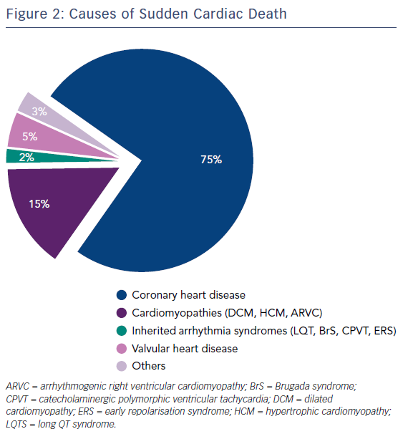
Srinivasan NT, Schilling R
Figure 2: Causes of Sudden Cardiac Death
Citation: Arrhythmia & Electrophysiology Review 2018;7(2):111–7.
https://doi.org/10.15420/aer.2018:15:2

