Slide 1
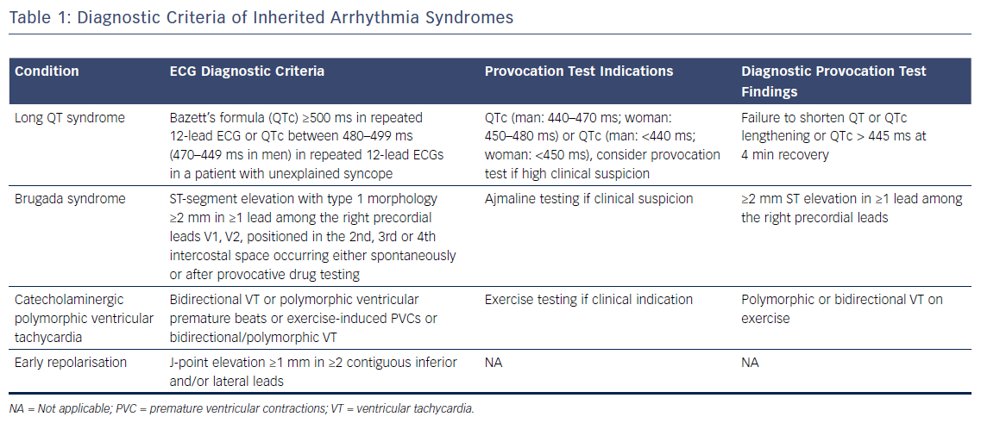
Srinivasan NT, Schilling R
Table 1: Diagnostic Criteria of Inherited Arrhythmia Syndromes
Citation: Arrhythmia & Electrophysiology Review 2018;7(2):111–7.
https://doi.org/10.15420/aer.2018:15:2

