Slide 1
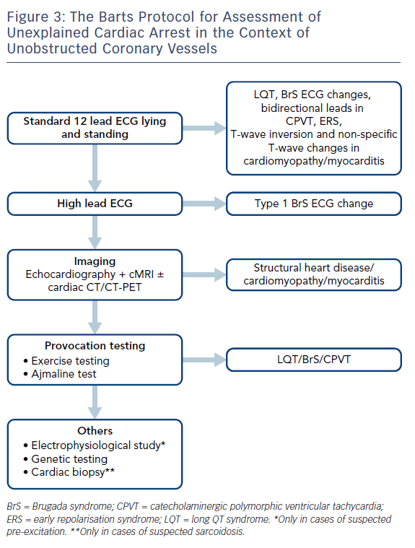
Srinivasan NT, Schilling R
Figure 3: The Barts Protocol for Assessment of&lt;br /&gt;&#10;Unexplained Cardiac Arrest in the Context of Unobstructed Coronary Vessels
Citation: Arrhythmia & Electrophysiology Review 2018;7(2):111–7.
https://doi.org/10.15420/aer.2018:15:2

