Slide 1
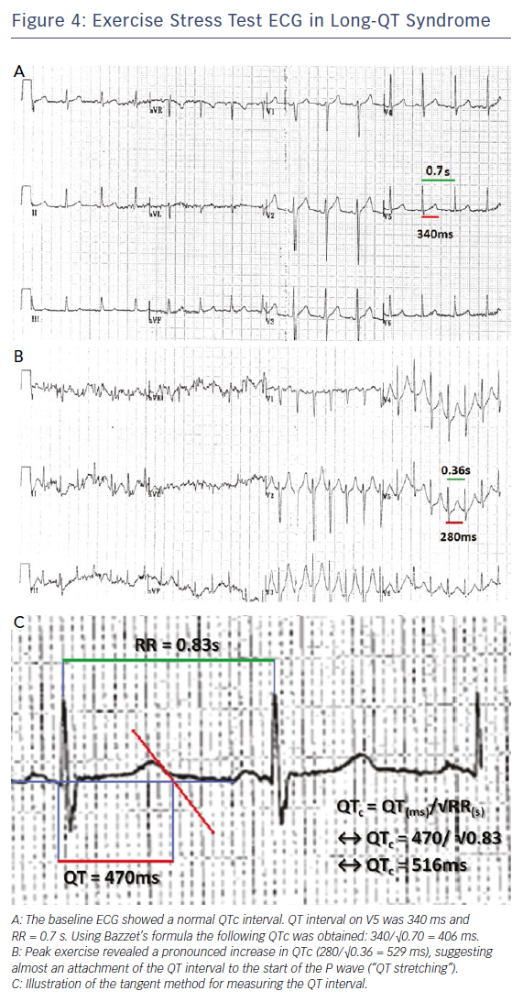
Srinivasan NT, Schilling R
Figure 4: Exercise Stress Test ECG in Long-QT Syndrome
Citation: Arrhythmia & Electrophysiology Review 2018;7(2):111–7.
https://doi.org/10.15420/aer.2018:15:2

