Slide 1
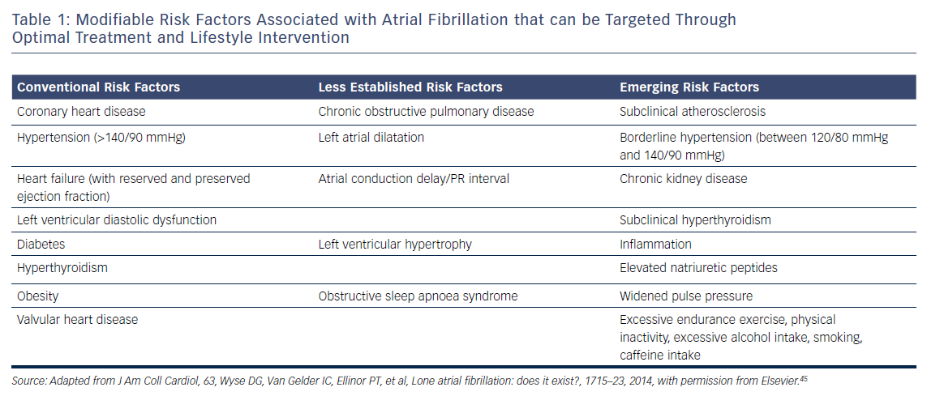
Brandes A, Smit MD, Nguyen BO, Rienstra M, Van Gelder IC
Table 1: Modifiable Risk Factors Associated with Atrial Fibrillation that can be Targeted Through Optimal Treatment and Lifestyle Intervention
Citation: Arrhythmia & Electrophysiology Review 2018;7(2):118–27.
https://doi.org/10.15420/aer.2018.18.2

