Slide 1
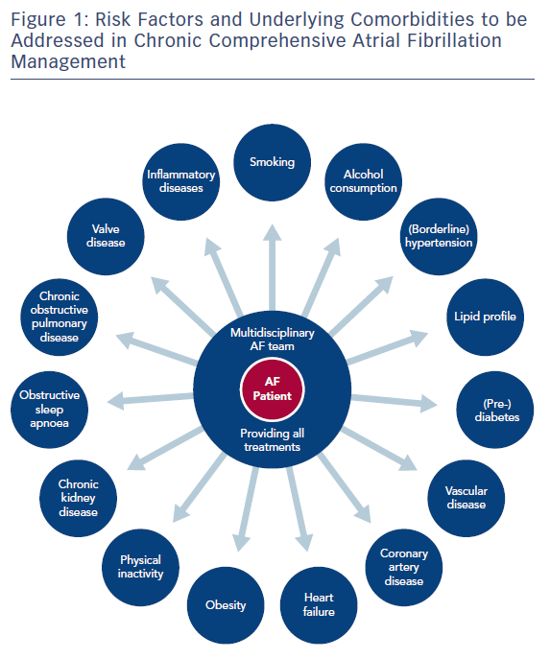
Brandes A, Smit MD, Nguyen BO, Rienstra M, Van Gelder IC
Figure 1: Risk Factors and Underlying Comorbidities to be Addressed in Chronic Comprehensive Atrial Fibrillation Management
Citation: Arrhythmia & Electrophysiology Review 2018;7(2):118–27.
https://doi.org/10.15420/aer.2018.18.2

